Slide 1
Bipolar Research
Stuart Watson
@NCMDresearch
@stuartW13044383
stuart.watson@ncl.ac.uk
www.mood-disorders.co.uk
Research register - NCMD (mood-disorders.co.uk)

Slide 2
Burden & Barriers
Seventh leading cause of disability worldwide
- Considerable economic burden
- Considerable personal burden
Reduced funds¹
Only 4% of research grants are for mental health studies
Of these, very few are for bipolar
Impact:
Basic science studies to determine biological causes and treatment targets
Pilot studies to prepare for larger studies
Qualitative studies to understand patients’ needs
Research infrastructure
Data to inform larger studies
Research council funded treatment studies
Recruitment
Essential for commercial research.
Essential for government funded research
But is incredibly difficult
¹Woelbert et al The Lancet Psychiatry March 2021
Notes:
Considerable economic burden:
Total annual cost in the UK of £2 billion
Direct NHS annual cost of £199 million
Drugs <1% of total costs
- Considerable personal burden; an individual with onset of bipolar disorder in mid–late 20s effectively loses:
9 years of life
12 years of normal health
14 years of work activi
Recruitment
Essential for commercial research. If GB is to compete in the Life Sciences Industry- important if we want to know if treatment works in an NHS setting.
Essential for government funded research if we are to improve understanding and test and develop new treatment strategies.
But is incredibly difficult
Patients separated from researchers- by:
Primary/secondary care barrier
Clinician paternalism
Inadequate registers
Busy doctors
Governance demands
Limited confidence in new products

Slide 4
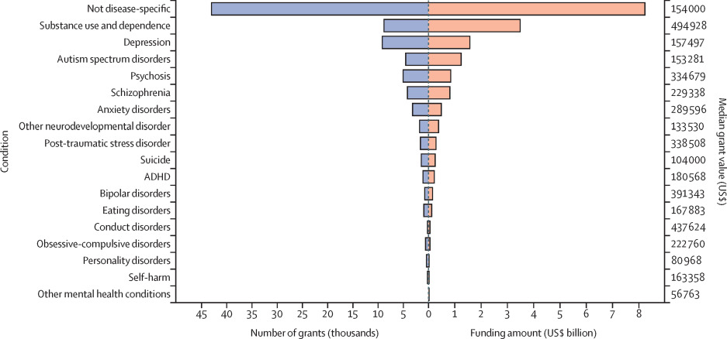
¹Woelbert et al The Lancet Psychiatry March 2021

Slide 5
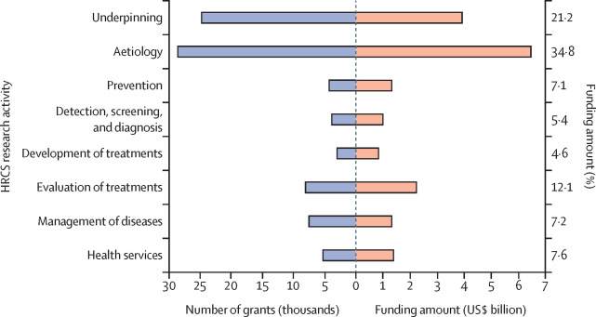
¹Woelbert et al The Lancet Psychiatry March 2021

Slide 6
Burden & Barriers
Seventh leading cause of disability worldwide
- Considerable economic burden
- Considerable personal burden
Reduced funds¹
Only 4% of research grants are for mental health studies
Of these, very few are for bipolar
Impact:
Basic science studies to determine biological causes and treatment targets
Pilot studies to prepare for larger studies
Qualitative studies to understand patients’ needs
Research infrastructure
Data to inform larger studies
Research council funded treatment studies
Recruitment
Essential for commercial research.
Essential for government funded research
But is incredibly difficult
¹Woelbert et al The Lancet Psychiatry March 2021
Notes:
Considerable economic burden:
Total annual cost in the UK of £2 billion
Direct NHS annual cost of £199 million
Drugs <1% of total costs
- Considerable personal burden; an individual with onset of bipolar disorder in mid–late 20s effectively loses:
9 years of life
12 years of normal health
14 years of work activi
Recruitment
Essential for commercial research. If GB is to compete in the Life Sciences Industry- important if we want to know if treatment works in an NHS setting.
Essential for government funded research if we are to improve understanding and test and develop new treatment strategies.
But is incredibly difficult
Patients separated from researchers- by:
Primary/secondary care barrier
Clinician paternalism
Inadequate registers
Busy doctors
Governance demands
Limited confidence in new products

Slide 7
Being in a clinical trial is therapeutic

Slide 8



A randomised, double-blind, placebo controlled trial of pramipexole in addition to mood stabilisers for patients with treatment resistant bipolar depression
www.paxbd.org
See mood-disorders.co.uk/PAX-BD
Notes:
Primary and secondary outcomes are self reported by participants online. No local pharmacy involvement, trial medication is posted by NTW directly to participant homes. Central NTW Research Assistants will provide regular contact with participants and feedback to sites.

Slide 9
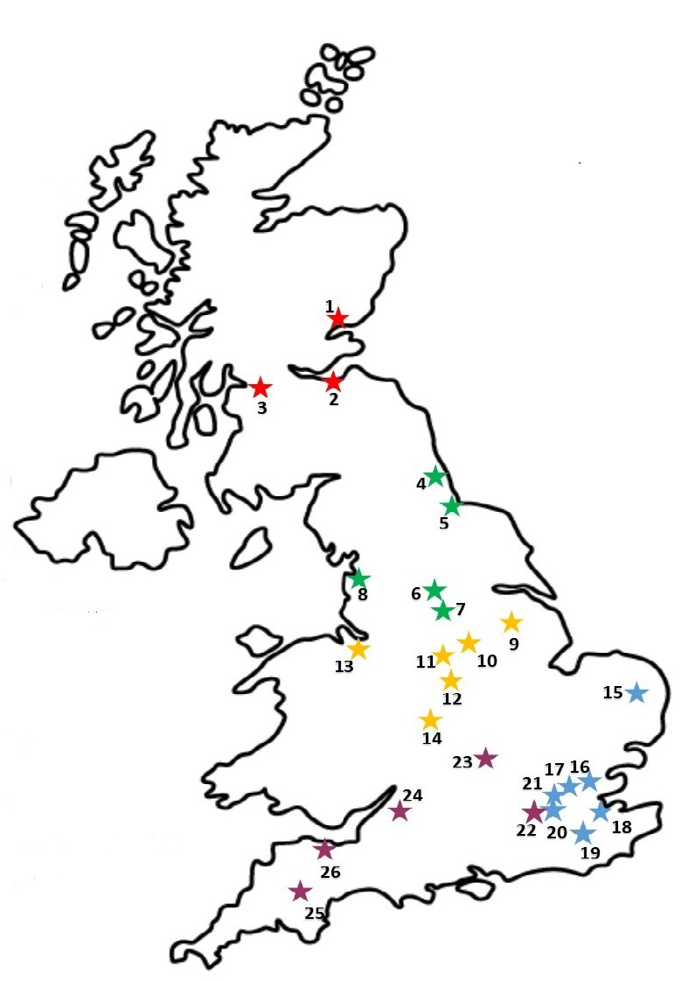
Funder: National Institute for Health Research (NIHR) Health Technology Appraisal (HTA) Panel
Sponsor: Northumberland, Tyne and Wear NHS Foundation Trust
Chief Investigator: Prof Hamish McAllister-Williams (Newcastle)
Co-Principle Investigators: Prof Danny Smith (Glasgow), Dr Stuart Watson (Newcastle), Prof Richard Morriss (Nottingham), Prof John Geddes (Oxford), Prof Allan Young and Dr Paul Stokes (London)

Slide 10
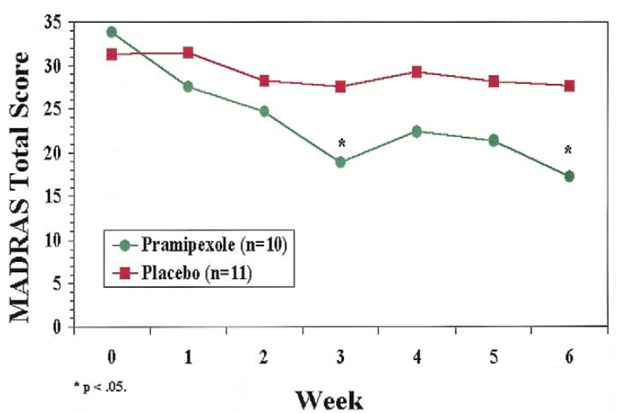
Pramipexole
Pramipexole (D3 and D2 agonist) Proof of concept in bipolar II
Increases dopamine transmission
Helps depression in Parkinson’s
Small trials indicate it may have a significant benefit in the treatment of bipolar depression.
NIHR commissioned the PAX-BD study to investigate this treatment further.
(Zarate et al. 2004)
Notes:
Zarate et al. 2004 Biol Psych 56:54-60

Slide 11
Depression, dopamine and reward
Negative mood states associated with distress- increased in depression¹ | Positive mood states associated with “well-being”- decreased in depression¹
Fear | Pleasure
Anxiety | Joy
Irritability | Interest
Loneliness | Motivation
Guilt | Energy
Disgust | Enthusiasm
Hostility | Alertness
Pessimism | Self-confidence
 | Driven by attenuated reward systems, predict poor response² particularly to SSRIs^{3,4} may be better with DA or NA drugs?
¹Lane RM (2015) J Psychopharm 2014, ² Spiker J (2001) Acta Psychiatr Scand, 103, 122-30, ³McMakin DL (2012) J Am Acad Child Adolesc Psychiatry, 51, 404-11, ⁴Uher R (2012) Psychol Med 967-80
Notes:
Wanting, liking, action initiation, response vigour

Slide 12
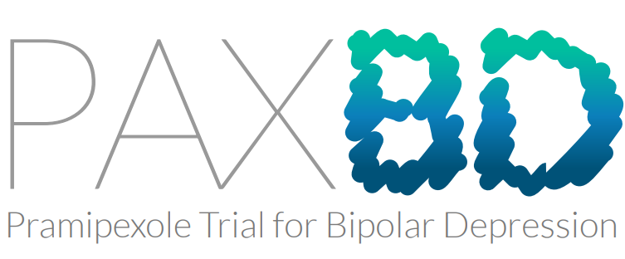
Population: Patients with Treatment Resistant Bipolar Depression
Intervention & Comparator:
  Randomised 1:1 to Pramipexole (fixed dose to 12 weeks then flexible) or placebo
  Added to existing mood stabilisers (lithium, valproate, carbamazepine, lamotrigine) - started if not already on
  Antipsychotics hopefully soon to be allowed
Sample size: 290 randomised participants
  Duration: 12 weeks primary outcome, 48 week FU
  Status: One participant completed. Trial has recently restarted. Sites continuing to open
(see https://paxbd.org/about/recruiting-sites)

Slide 13
Inclusion Criteria
Aged over 18
Bipolar (type I or II)
Currently depressed with QIDS-SR score >10 (see https://mood-disorders.co.uk/questionnaire/qids)
Treatment resistant depression (2 recommended treatments - quetiapine, olanzapine, lamotrigine or lurasidone either not appropriate, failed or not tolerated)
Receiving care from a participating site (see https://paxbd.org/about/recruiting-sites)

Slide 14
ASCEnD
Aripiprazole, sertraline combination: clinical and cost effectiveness in bipolar depression
Submitted as a bid to NIHR (HTA board)
Outcome expected end of April
RCT- aripiprazole/sertraline combo (ASC) vs quetiapine
24 week study
270 participants across 10 UK centres (Newcastle, London, Oxford, Nottingham, Bristol, Somerset, Cornwall, Birmingham, Brighton, Southern)

Slide 15


Acute depression: BAP guidelines
If not already on long-term treatment
  Consider quetiapine, lurasidone, olanzapine or Lamotrigine
  There is great uncertainty about antidepressants
    if antidepressants are used, they should be co-prescribed with a drug for mania
  Consider Electroconvulsive treatment (ECT)
  Lithium if less severe (as prelude to long-term treatment)
Whilst taking long term treatment
  Check doses are adequate and that serum concentrations of lithium are in the therapeutic range
  Address current stressors, if any
While antidepressants are efficacious in unipolar depression they are ineffective in bipolar disorder when used with mood stabilisers or alone

Slide 16

Primary Care
Secondary Care

Slide 17
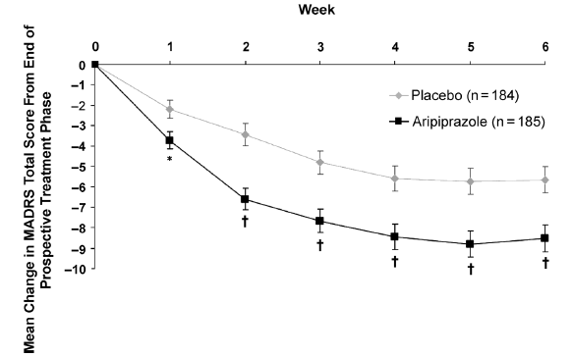
Aripiprazole* augmentation after inadequate response to SSRI/SNRIs
*Aripiprazole does not have a licence for augmentation in refractory depression in Europe
Start dose = 5mg, mean = 11mg
Marcus, R. N., McQuade, R. D., Carson, W. H., et al (2008) The efficacy and safety of aripiprazole as adjunctive therapy in major depressive disorder: a second multicenter, randomized, double-blind, placebo-controlled study. Journal of Clinical Psychopharmacology, 28, 156-165.
Notes:
Although Aripiprazole demonstrates effectiveness against placebo, only 3.1% had failed to respond to more than 2 antidepressant trials.
Like most studies, data are lacking in more resistant populations.
17

Slide 18
Average discontinuation (%) due to adverse events in short-term MDD trials
Berman RM,, et al. Aripiprazole Augmentation in Major Depressive Disorder: A Double-Blind, Placebo-Controlled Study in Patients with Inadequate Response to Antidepressants. CNS Spectrums. 2009; 14(4): 197-206.
Marcus RN, et al. The efficacy and safety of aripiprazole as adjunctive therapy in major depressive disorder: a second multicenter, randomized, double-blind, placebo-controlled study. J Clin Psychopharmacol. 2008; 28(2): 156-65.
Berman RM, et al. The efficacy and safety of aripiprazole as adjunctive therapy in major depressive disorder: a multicenter, randomized, double-blind, placebo-controlled study. The Journal of clinical psychiatry. 2007; 68(6): 843-53.
Bauer M, et al. Extended-release quetiapine as adjunct to an antidepressant in patients with major depressive disorder: results of a randomized, placebo-controlled, double-blind study. The Journal of Clinical Psychiatry. 2009; 70(4): 540-9.
El-Khalili N,, et al. Extended-release quetiapine fumarate (quetiapine XR) as adjunctive therapy in major depressive disorder (MDD) in patients with an inadequate response to ongoing antidepressant treatment: a multicentre, randomized, double-blind, placebo-controlled study. Int J Neuropsychopharmacol. 2010; 13(7): 917-32.
McIntyre A, et al.. Quetiapine adjunct to selective serotonin reuptake inhibitors or venlafaxine in patients with major depression, comorbid anxiety, and residual depressive symptoms: a randomized, placebo-controlled pilot study. Depress Anxiety. 2007; 24(7): 487-94.
Kamijima K,, et al. Aripiprazole augmentation to antidepressant therapy in Japanese patients with major depressive disorder: A randomized, double-blind, placebo-controlled study (ADMIRE study). J Affect Disord. 2013; 151(3): 899-905.
Thase ME et al. A randomized, double-blind comparison of olanzapine/fluoxetine combination, olanzapine, and fluoxetine in treatment-resistant major depressive disorder. The Journal of clinical psychiatry. 2007; 68(2): 224-36.
Shelton RC, et al. Olanzapine/fluoxetine combination for treatment-resistant depression: a controlled study of SSRI and nortriptyline resistance. The Journal of clinical psychiatry. 2005; 66(10): 1289-97.
Corya SA, et al. A randomized, double-blind comparison of olanzapine/fluoxetine combination, olanzapine, fluoxetine, and venlafaxine in treatment-resistant depression. Depress Anxiety. 2006; 23(6): 364-72.

Slide 19
Conclusion
Bipolar disorder is being actively investigated as a focus in Newcastle, Oxford, Nottingham, London and Glasgow
There is a real need for this work- particularly to improve treatment options
Lack of funding and difficulties in “recruitment” are major challenges
Pax-BD is an important current study
Fingers crossed for ASCEnD

